Slide 1
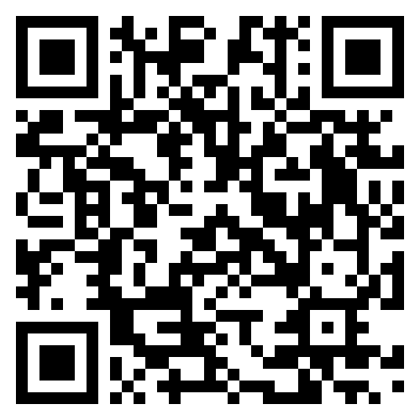




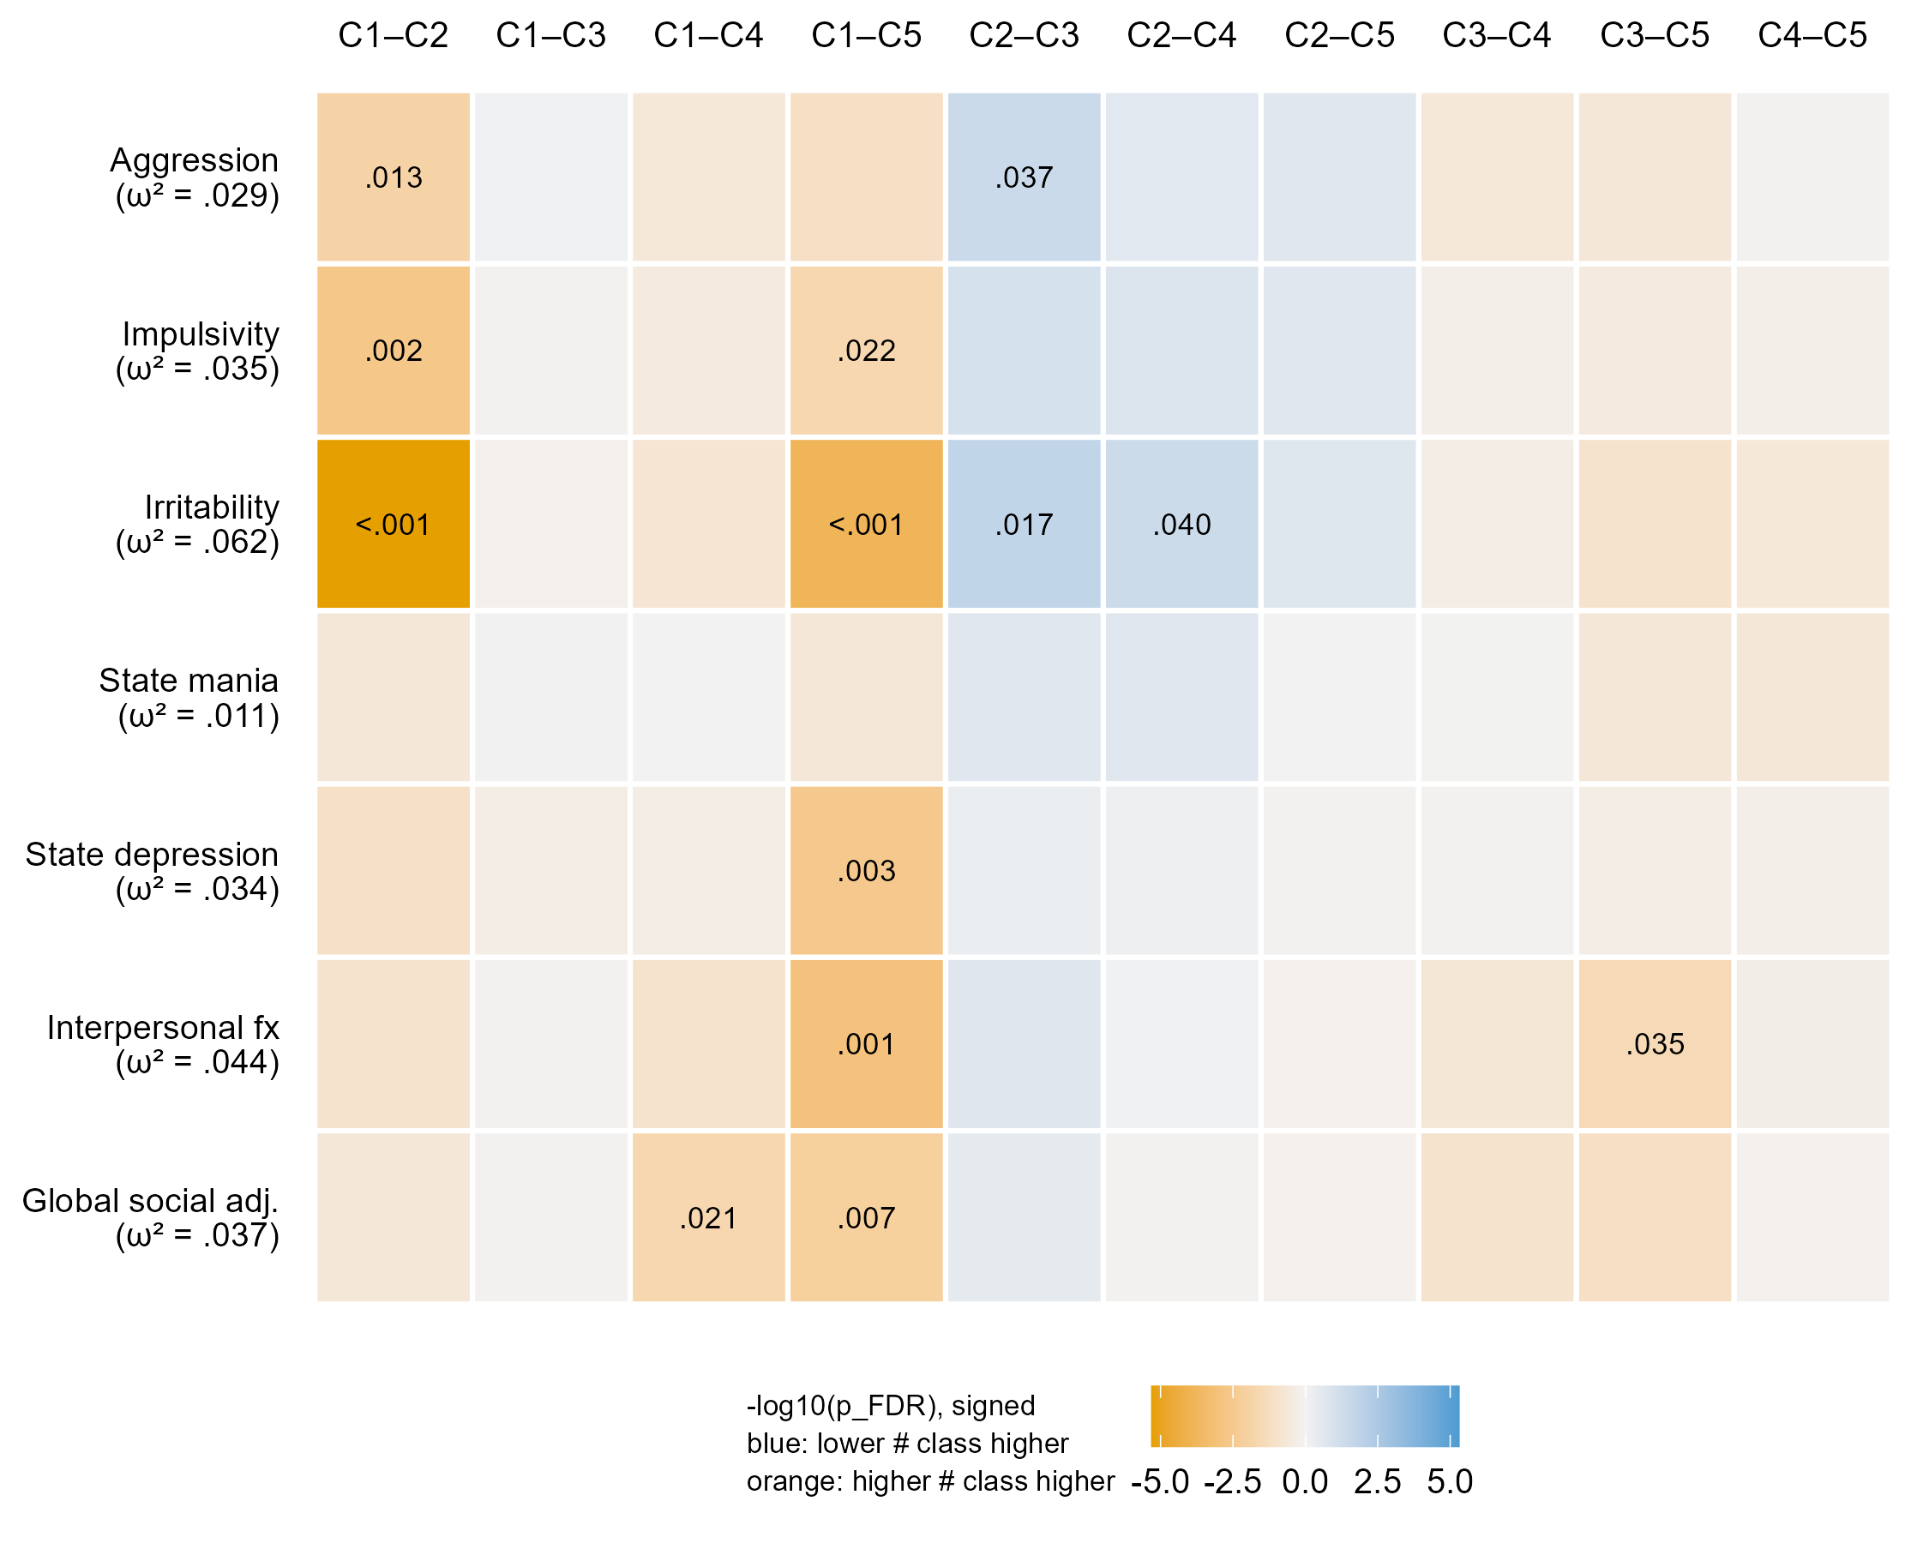
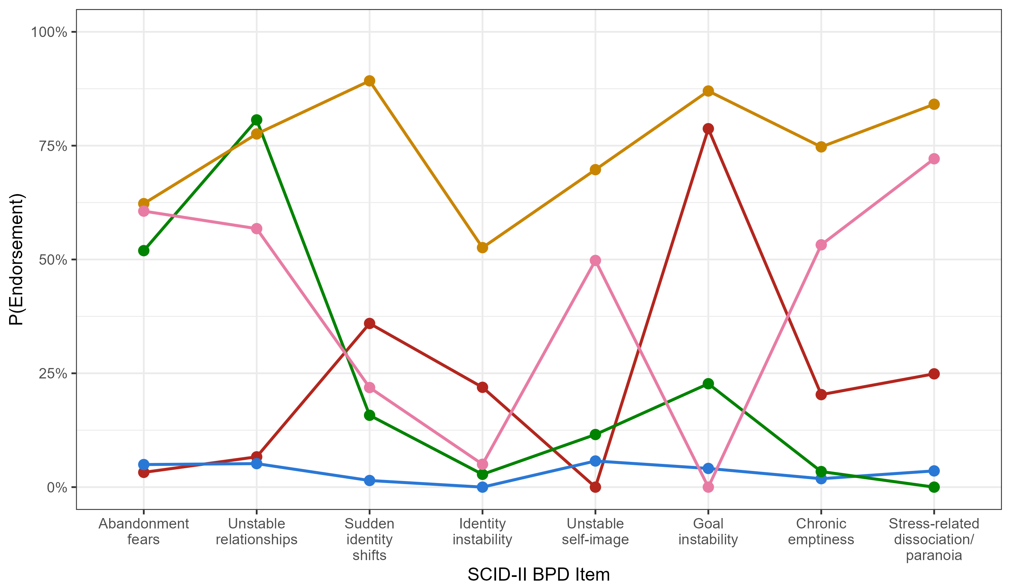
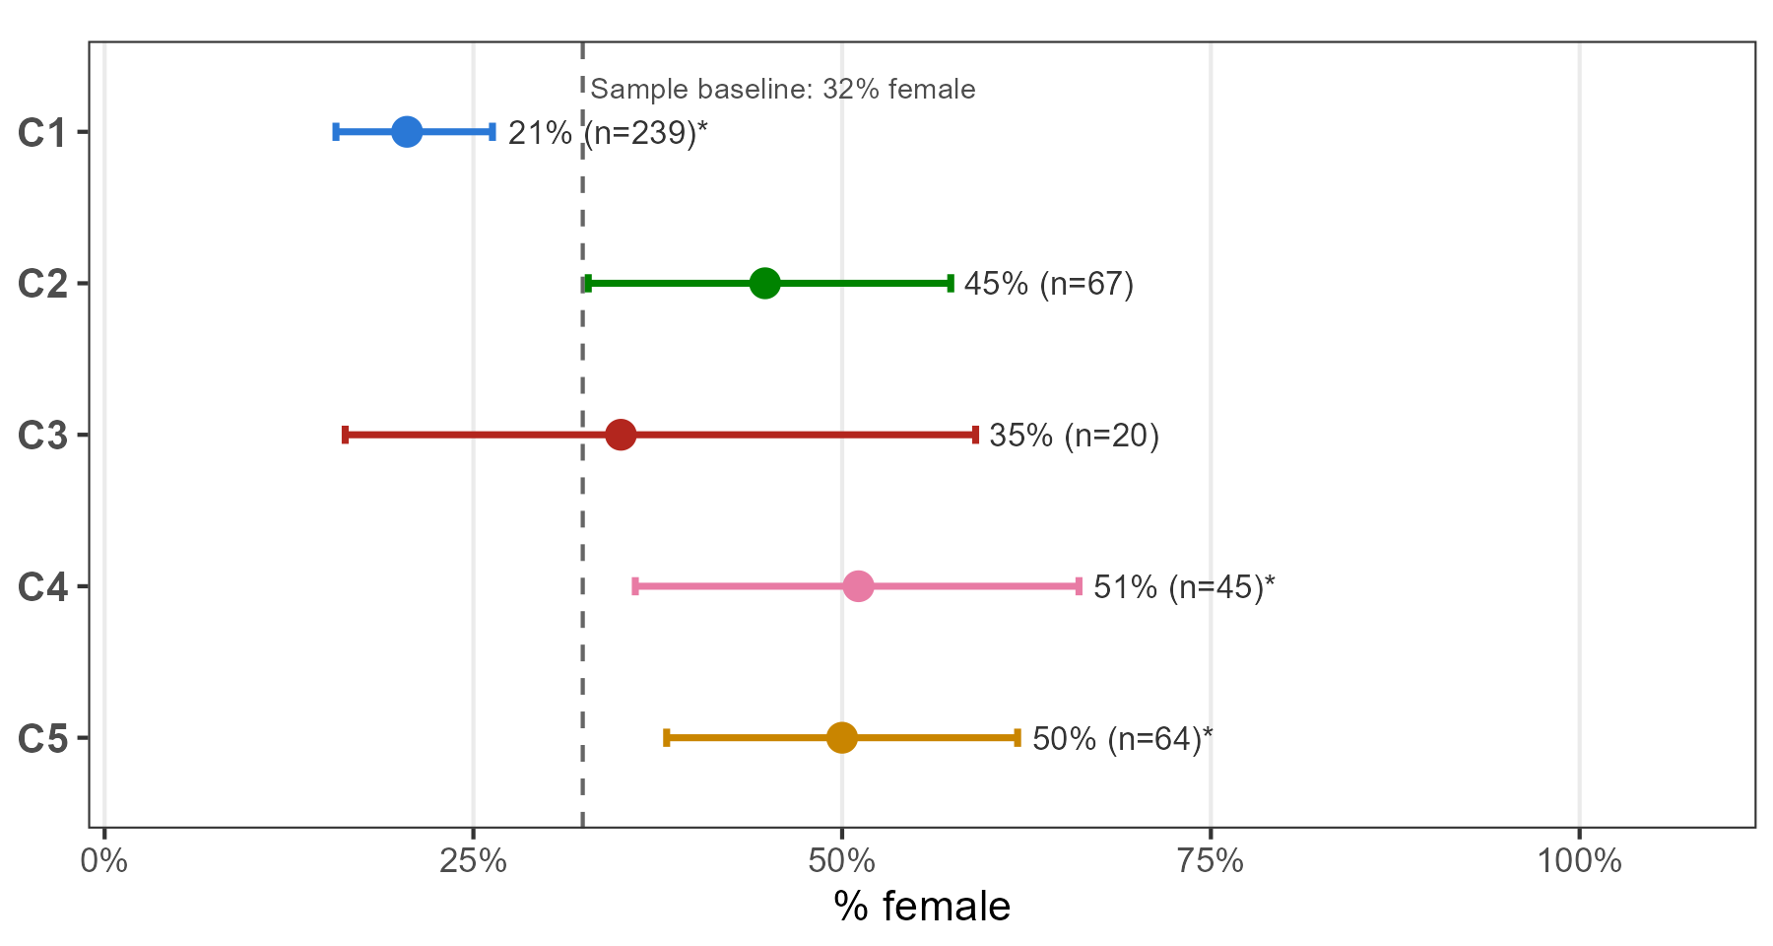

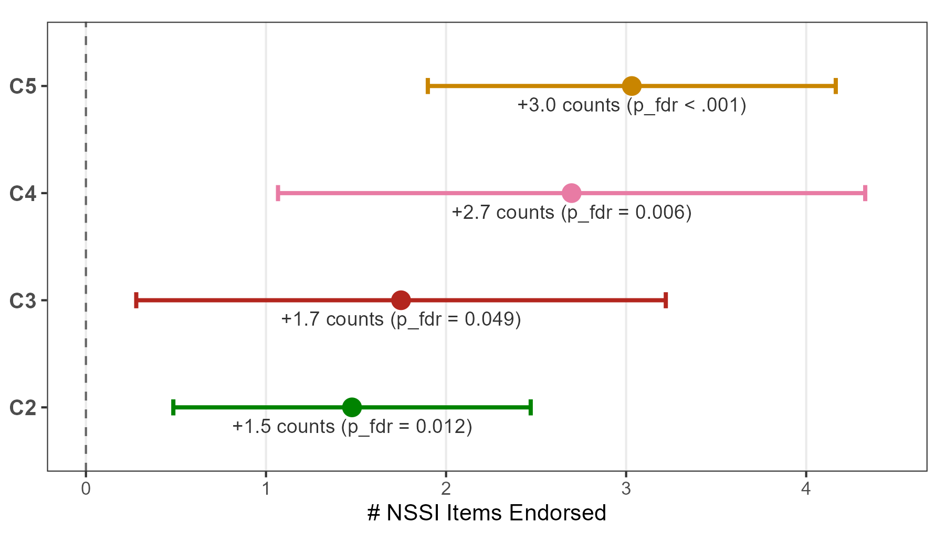
Latent Classes of Borderline Personality Features Differentiate Self-Harm in Youth with Elevated Symptoms of Mania
Margaret V. Meyers^{1,2}, Kevin G. Stephenson, Ph.D.^{1,3}, Cristian Alcaino, Ph.D.¹, Eric A. Youngstrom, Ph.D.^{1,4}
Scan for OSF & Supplementary Materials
¹The Institute for Mental and Behavioral Health Research, Nationwide Children's Hospital; ²University of North Carolina at Chapel Hill; ³Brigham Young University; ⁴Department of Psychiatry, The Ohio State University
INTRODUCTION
RESULTS
Borderline personality features (BPFs), such as identity disturbance and unstable interpersonal relationships, increase risk of suicidal behavior in youth.¹
Identifying borderline personality features may inform self-harm risk assessment for youth with elevated manic symptoms.
Concurrent validators. Classes differed significantly across all validators besides state mania (Figure 3).
Classes also differed on sex distribution (Figure 4; χ² = 36.4, p < .001).
Comorbid BPFs independently contribute to suicidality in individuals with bipolar disorder.²
C2 was consistently elevated on aggression, impulsivity, and irritability
However, whether BPFs differentiate clinical subtypes of youth at risk for bipolar disorder (elevated manic symptoms) remains unknown.
C1 was more male than entry sample (20.5% female), while C2 and C4 trend more female (44.8%, 51.1%, male 50.0%)
OBJECTIVES
1
Evaluate how assessment of BPFs support transdiagnostic approaches for youth with elevated manic symptoms.
2
Expand borderline personality pathology beyond a single, undifferentiated risk factor.
METHOD
Sample. Youth (N = 435; 68% male, 32% female) recruited from outpatient clinics were enrolled for elevated manic symptoms.
Indicators. 8 SCID-II BPD identity disturbance and relational instability items; latent class analysis run with poLCA R package.³
Enumeration. Fit for 1 to 6 class solutions was compared.
Class to validator differences. Manual bias-adjusted three-step (BCH)^{4,5} was calculated after fitting the 5-class model (K = 5) using validators of trait aggression, impulsivity, irritability, interpersonal functioning, global social adjustment, and state mania and depression.
FIGURE 3. Pairwise class contrasts across concurrent validators for the five-class model. Class differences were evaluated using BCH-adjusted Wald tests with FDR-corrected pairwise comparisons (cell text). Effect sizes (ω²) reflect magnitude of between-class differences (cell rows).
Each validator was measured concurrently at the youth’s last completed SCID-II assessment.
Validators were chosen based on literature describing features common to borderline personality and bipolar disorder.⁶
Detailed methods summary with full results output available on OSF.
RESULTS
Model selection. Model-selection indices disagreed (BIC/CAIC favored K = 2; aBIC and the bootstrap likelihood ratio test favored 4+ classes); a 5-class solution was chosen as the primary model to balance fit (aBIC-favored) with clinical interpretability (Figure 1).
Self-harm outcomes. Non-suicidal self-injury was assessed in a subsample (n = 310) that completed the Youth Risk Behavior Survey (Figure 2).
Classes differentiated NSSI on a winsorized frequency count (ω² = .17)
FIGURE 4. % female by class vs. % female at sample baseline (32%, dashed line; 95% CIs)
DISCUSSION
C1 (Minimal Features) was distinguishable from every class on concurrent NSSI frequency and sex.
Classes reflect distinct different risk pathways, supporting the clinical utility of BPF assessment for identifying differential risk among youth with elevated manic symptoms.
FIGURE 1. Item endorsement profiles for the 5-class model (N = 435).
C1 floors all items; C2 displays elevated abandonment fears/unstable relationships, flooring on identity items; C3 elevated on identity/goal items with minimal interpersonal component; C4 shows moderate relational/self-image disturbance plus stress-related dissociation/paranoia; C5 endorses most SCID-II BPD items.
Limitations. Validators are concurrent and do not show prediction of self-harm outcomes.
Future Directions. Further work should employ prospective panels to evaluate whether BPFs carry clinical information about risk of suicidal behavior that concurrent mood state alone may not.
FIGURE 2. NSSI item endorsement (winsorized) across classes vs. C1
Notes:
OSF DOI: https://doi.org/10.17605/OSF.IO/P32DX
GitHub repository: mvmeyers/Borderline-Features-LCA: RISE 2026 - Summer Student Poster Day Supplementary Materials
Supplementary materials include code for the manual bias-adjusted three-step BCH, complete omnibus Wald test results, and an expanded Method section.

